Slide 1

ATTENTION DEFICIT HYPERACTIVIY DISORDER (ADHD) DETECTION AND PROVIDING THERAPEUTIC TREATMENT USING IOT
Project Guide : Mr Jemin V M
Assistant Professor Of RMKCET
Team Members :
1. Sudharsan R (111620104157)
2. Veekshith E R (111620104169)
3. Tharun M (111620104157)

Slide 2
Agenda
Objective
Abstract
Literature survey
Existing system and drawbacks
Proposed System
System Architecture
Hardware and Software Requirements
No of modules
Output Screenshot
Conclusion
References

Slide 3
INTRODUCTION
ADHD, or Attention Deficit Hyperactivity Disorder, manifests as inattention, hyperactivity, and impulsivity, leading to restlessness and difficulty in focusing that can impair daily functioning. While there's no cure, treatment options, including medication and behavioral therapy, help manage symptoms. ADHD affects 4-12% of school students, with common signs like inattention and impulsivity. Despite its chronic nature, therapeutic management is possible, and it often continues into adulthood. Approximately 10 million Indian children are diagnosed with ADHD annually, and parents, alongside therapists, play pivotal roles in its treatment.

Slide 4
OBJECTIVE
To mainly focus on the detection of hypertension and restlessness in ADHD patients which leads to lack of attention and hyperactivity.
We use pulse, sweat and accelerometer sensor to identify the symptom.
To provide therapeutic based treatment using portable device for the speedy recovery of ADHD patients.

Slide 5
EXISTING SYSTEM
The existing system for ADHD mainly focus on heavy medications and strong injections which keep the patients always in a state of drowsiness.
Treatment is always based on EEG and MRI reports.
Counselling process given to the patients is very tiresome.
Drawbacks :
1) Sleep problems
2) Decreased appetite
3)Headache and stomach ache.

Slide 6
PROPOSED SYSTEM
.
In the Proposed System, we use non invasive techniques to overcome hypertension, restlessness and provide a therapeutic solution which gradually helps the patients to come out of the trauma state .
The device proposed in our system is portable and can be used daily irrespective of their age.
Our device acts as a supportive therapy which helps in the speedy recovery of ADHD patients.
Advantages :
1)Cost efficient.
2) Requires minimum technical knowledge.
3) Easy handling.

Slide 7
LITERATURE REVIEW
s.no | Title | Author | Journal, Year | Methodology used | Limitations / Observations
1 | Wearable Brain Computer Interface Instrumentation for Robot based rehabilitation by Augmented Reality. | Arpaia.P,Duraccio.L Moccaldi.N, & Rossi,S. | IEEE Transaction on instrumentation and measurement Vol 69,2020. | Controlling the movement of robot by using augmented reality glasses | Robo plays the role of therapist which involves high cost.
2 | Smart Home Environment to support Homework Activities for children | Jonathan Berrezuata-Guzman,Iran Pau,Maria-Ruiz; | IEEE Access, Vol 8,2020 | Perform homework by ADHD children by using smart objects. | Aims at improving the schooling activities of ADHD children.

Slide 8
LITERATURE REVIEW
S.no | Title | Author | Journal, Year | Methodology used | Limitations / Observations
3 | Classification of ADHD individuals and neurotypicals using reliable relief | B.Miao, L. L. Zhang, J. L. Guan, Q. F. Meng and Y. L. Zhang, | IEEE Access, vol. 7, pp. 62163-62171, 2019. | A novel framework is used for the classification of ADHD individuals and neurotypicals. | Only classification is done between individuals with autism & ADHD.
4 | Investigation of ADHD Assessment Using Electro Interstitial Scan Based on Chronoamperometry Technique | Ree Nah Chua,Yuan Wen Hau,Chew Ming Tiew. | IEEE Access Volume: 7 2019 | To investigate ADHD in children aged from 7 to 14 years at primary schools using Electro Interstitial Scan (EIS) . | This is only assessment method, not the treatment

Slide 9
SYSTEM ARCHITECTURE
LCD DISPLAY
PULSE SENSOR
CAP
MICROCONTROLLER
SWEAT SENSOR
NON –INVASIVE THERAPEUTIC TREATMENT
NERVOUSNESS DETECTION SENSOR
POWER SUPPLY

Slide 10

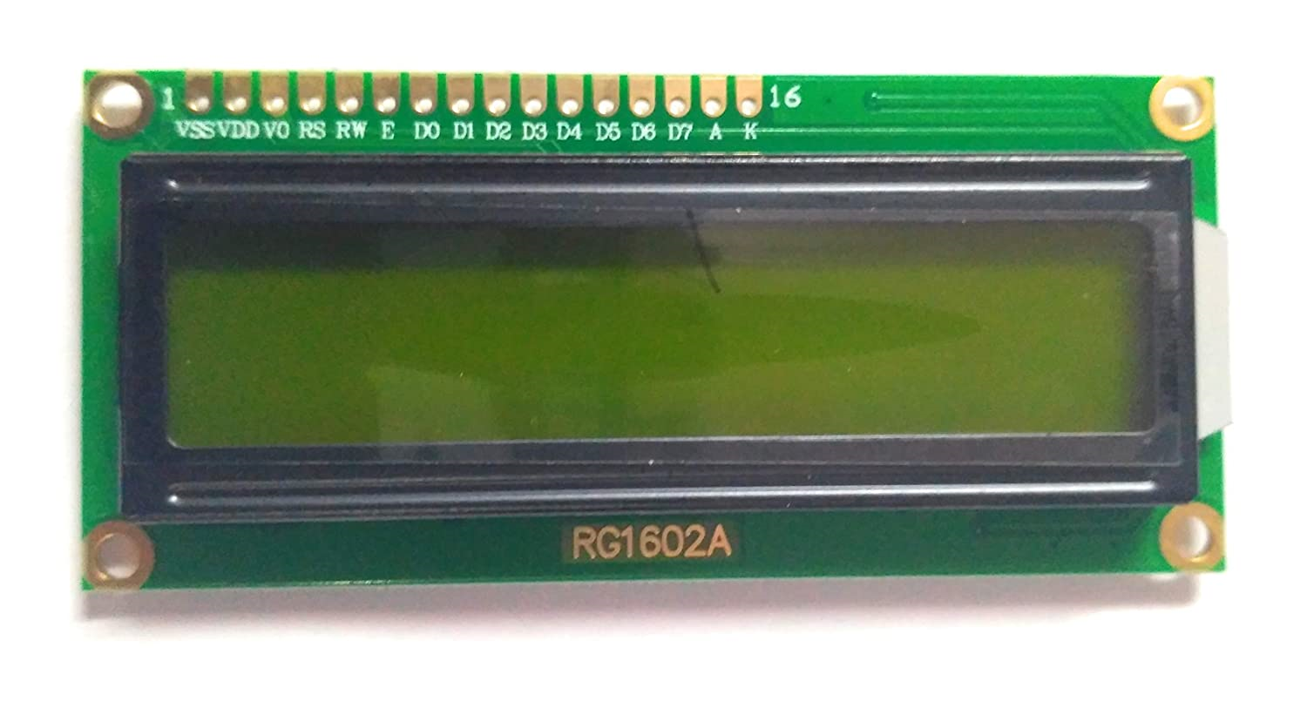
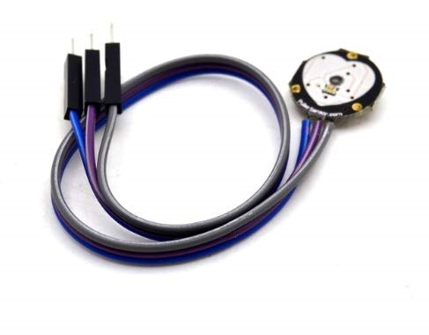


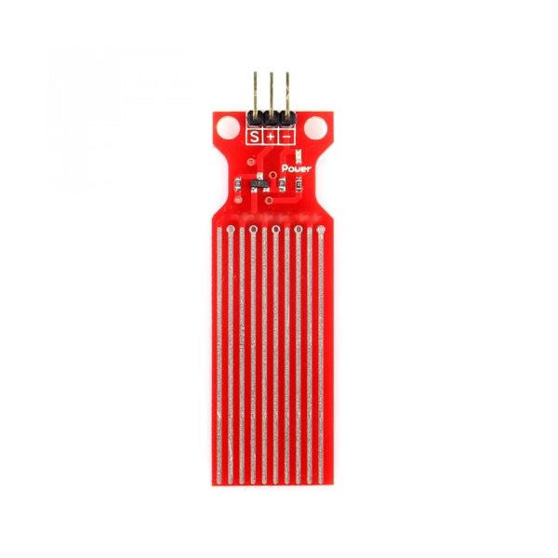

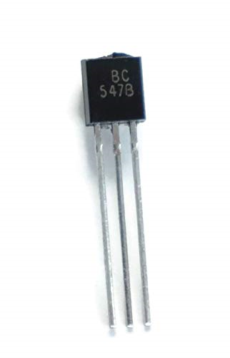
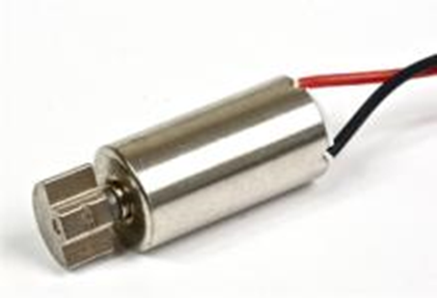

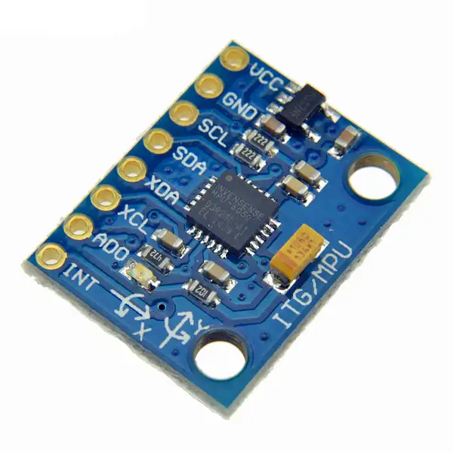
LCD Display
Pulse Sensor
Sweat Sensor
Vibration motor

Slide 11
LIST OF MODULES:
Module 1: Integration of sweat, pulse and accelerometer sensor with microcontroller.
Module 2: Testing the output of the sensors in the LCD Display.
Module 3: Providing therapeutic treatment using vibration motors.

Slide 12
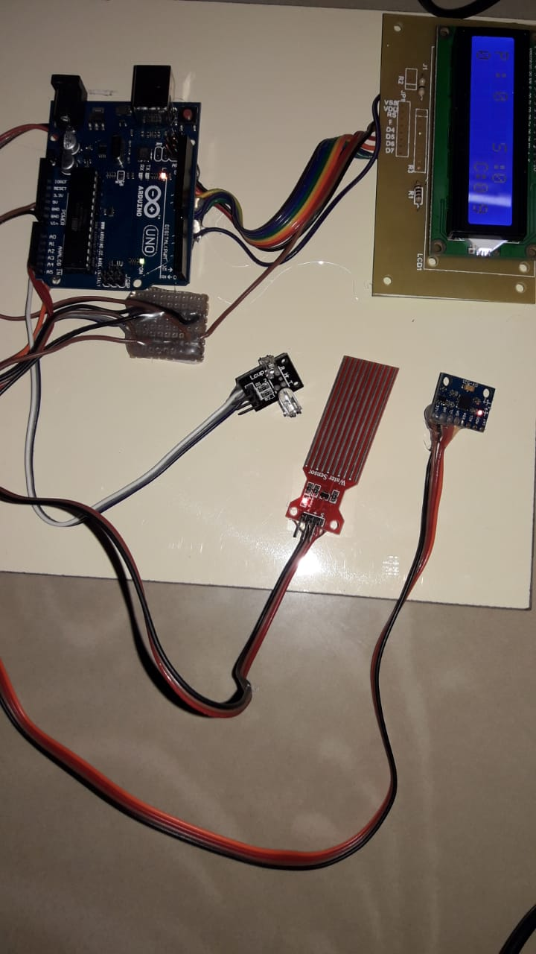
MODULE 1:
Integration of sweat, pulse and accelerometer sensor with microcontroller
The sweat sensor is used to detect the sweat-rate of a person. Pulse sensor is used to measure the pulse rate of a person. Accelerometer sensor is used to determine the movement of the object.

Slide 13


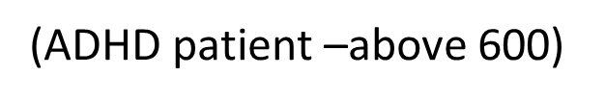
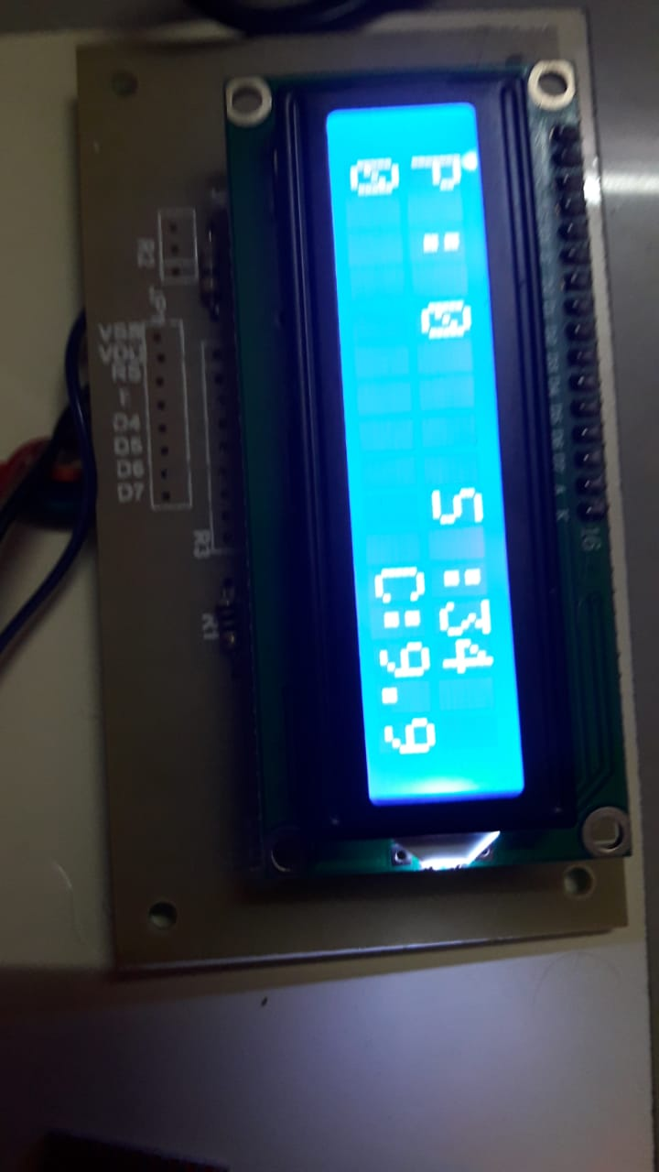
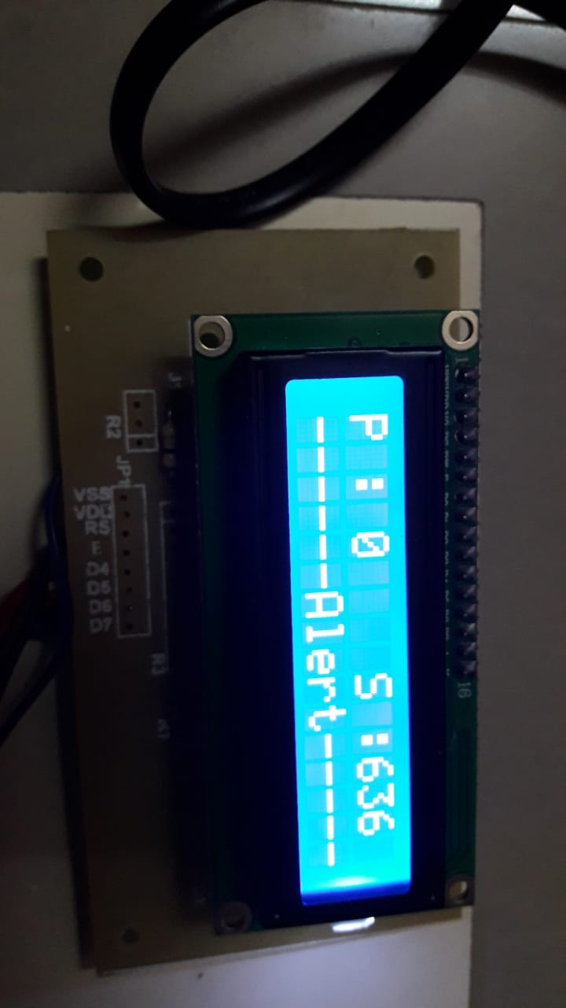
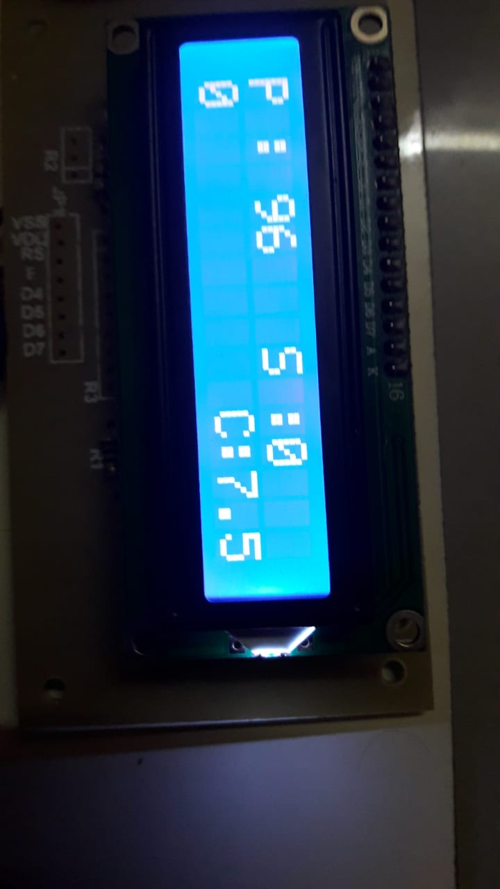
MODULE 2:
Testing the output of the sensors in the LCD Display.

Slide 14
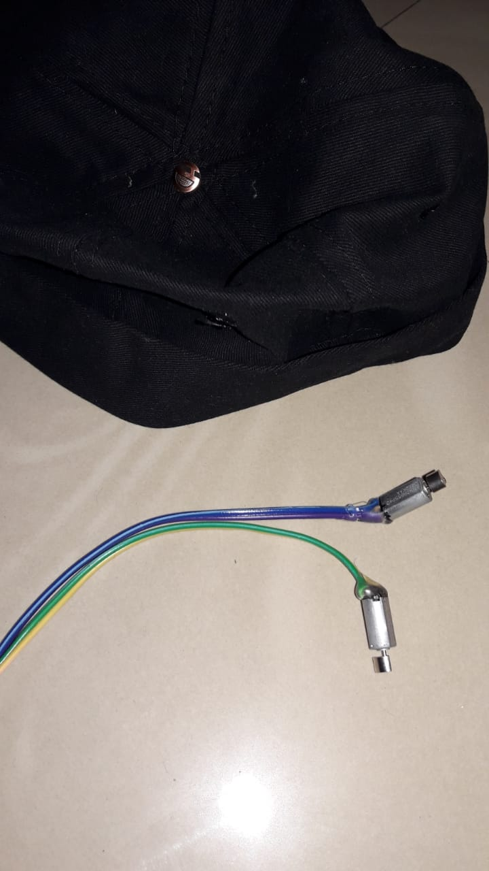
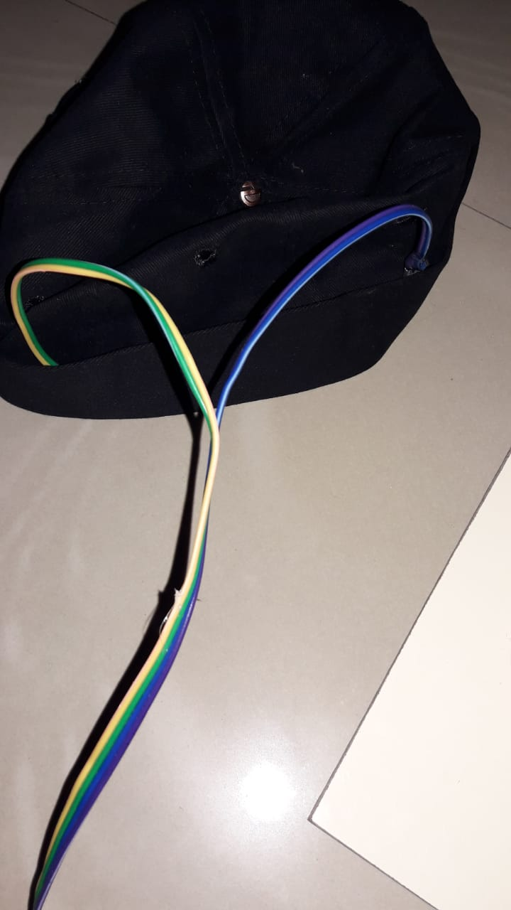
MODULE 3:
Providing therapeutic treatment using vibration motors

Slide 15
REQUIREMENTS:
Software Requirements:
Arduino IDE
2. Hardware requirements:
Arduino Microcontroller
Pulse Detection sensor
Sweat Detection sensor
Nervousness Detection sensor (accelerometer sensor)
Power Supply
Vibration Motor for Therapy
LCD 16*2

Slide 16
CONCLUSION
Thus our project focuses on the therapeutic treatment for the ADHD patient when they have high pulse rate, sweat rate, nervousness using vibration motors which improve blood circulation and make them feel relaxed. This device is simple and cost effective.

Slide 17
OUTPUT SCREENSHOTS:

Slide 18
THANK YOU

